Slide 1

Futurense Technologies
Project Report
Group 10 Names:
1.Guruakash
2.Naveen KM
3.RajulRaj
4. Ruthvik Sharma
5. Saurav KR Majumdar

Slide 2
Index
Project Statement
Description
Code
Figures/Graph

Slide 3
Project Statement
The healthcare department wants to process the 2011 census data (Data/census2011.csv) to find some relevant information about their department.
However, there is a lot of information in the data that is not relevant and can be ignored.
There are differences in the nomenclature in different datasets so a uniform nomenclature needs to be found as well. New states and Union Territories have been formed at the time of analysis which has to be taken care of so that the data can be used with the data that was captured later.
It is also reported that some data is missing in the dataset. However, the values of some of these missing data can be found by using data from other fields.
You have been given the responsibility to address these problems and create clean data that can be used later.

Slide 4
Description
Name of Dataset: census_2011, housing
Data format: CSV
Size of the dataset: 640 rows and 118 columns
Description of the Dataset:
Contains demographic and socio-economic information based on the 2011 census conducted in India. It includes data at the state and district levels, providing insights into population characteristics, education, employment, and other relevant factors.
Data Dictionary:
- `State name`: Categorical
- `District name`: Categorical
- `Population`: Numerical
- `Male`, `Female`: Numerical
- `Literate`, `Male_Literate`, `Female_Literate`: Numerical
- `Rural_Households`, `Urban_Households`, `Households`: Numerical
- `Age_Group_0_29`, `Age_Group_30_49`, `Age_Group_50`, `Age not stated`: Numerical
Missing values: 421
Pre-processing steps: Handling missing values, Dropping unnecessary column,

Slide 5
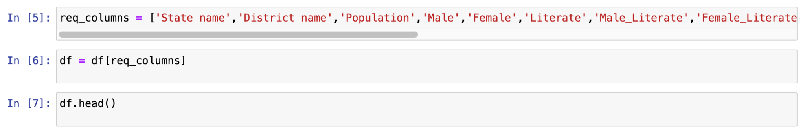
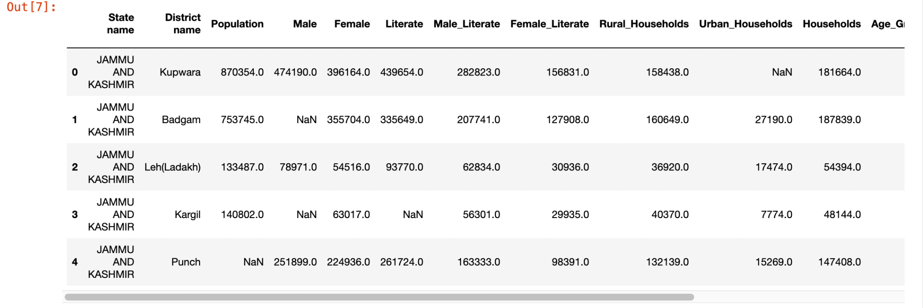
Code & Output
PS1: The census 2011 file contains many fields, which we may not use.
Remove some columns so that we are left with only relevant data.

Slide 6
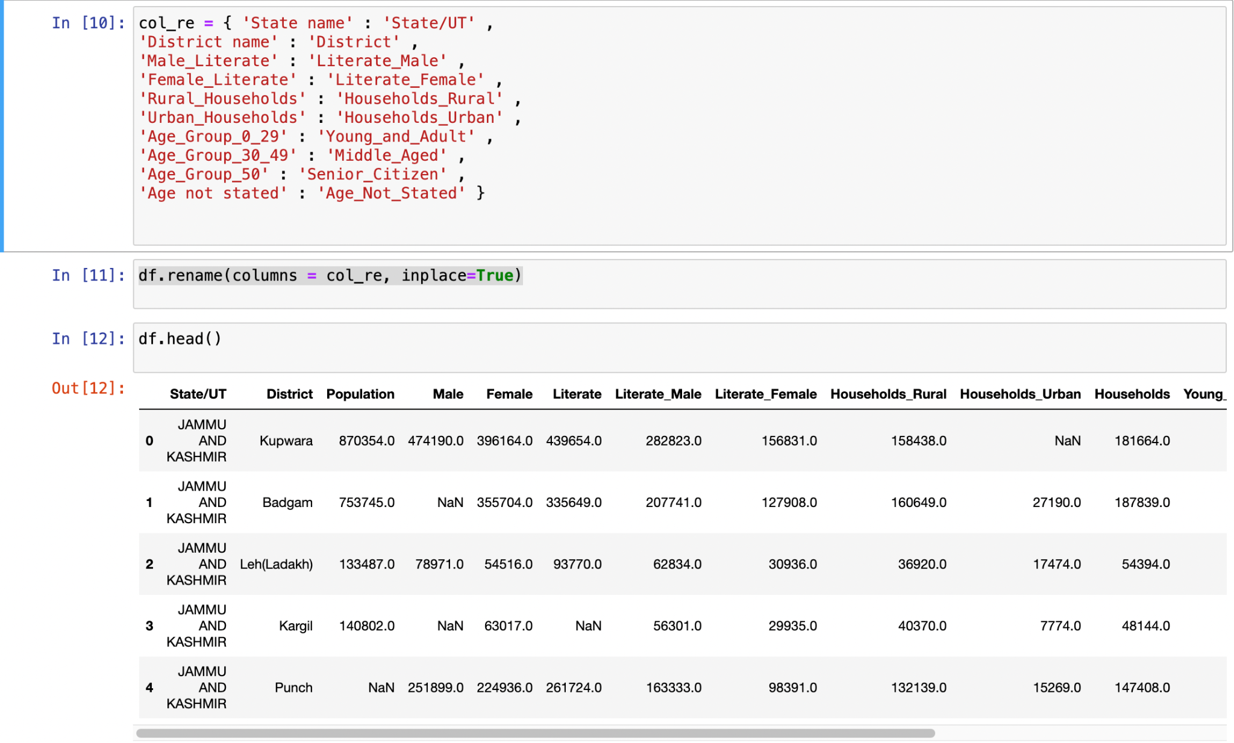
Code & Output
PS2: For uniformity in the datasets and taking into consideration the census year, we need to rename some columns.

Slide 7
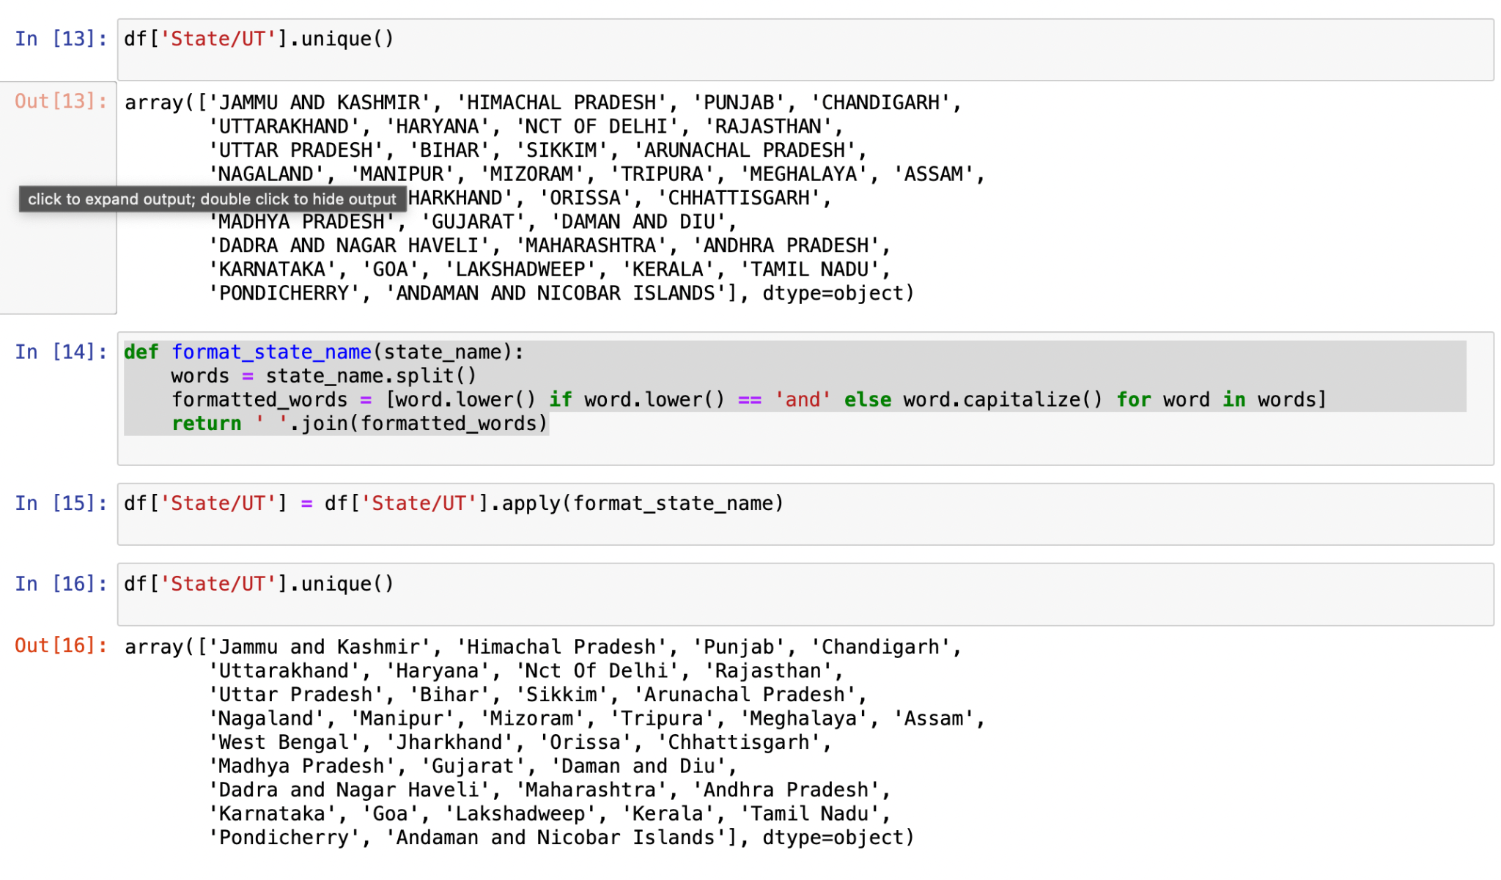
Code & Output
PS3: The State/UT names are in all caps in the census data, For uniformity across datasets we use the names so that only the first character of each word in the name is in upper case and the rest are in lower case. However, if the word is “and” then it should be all lowercase.

Slide 8
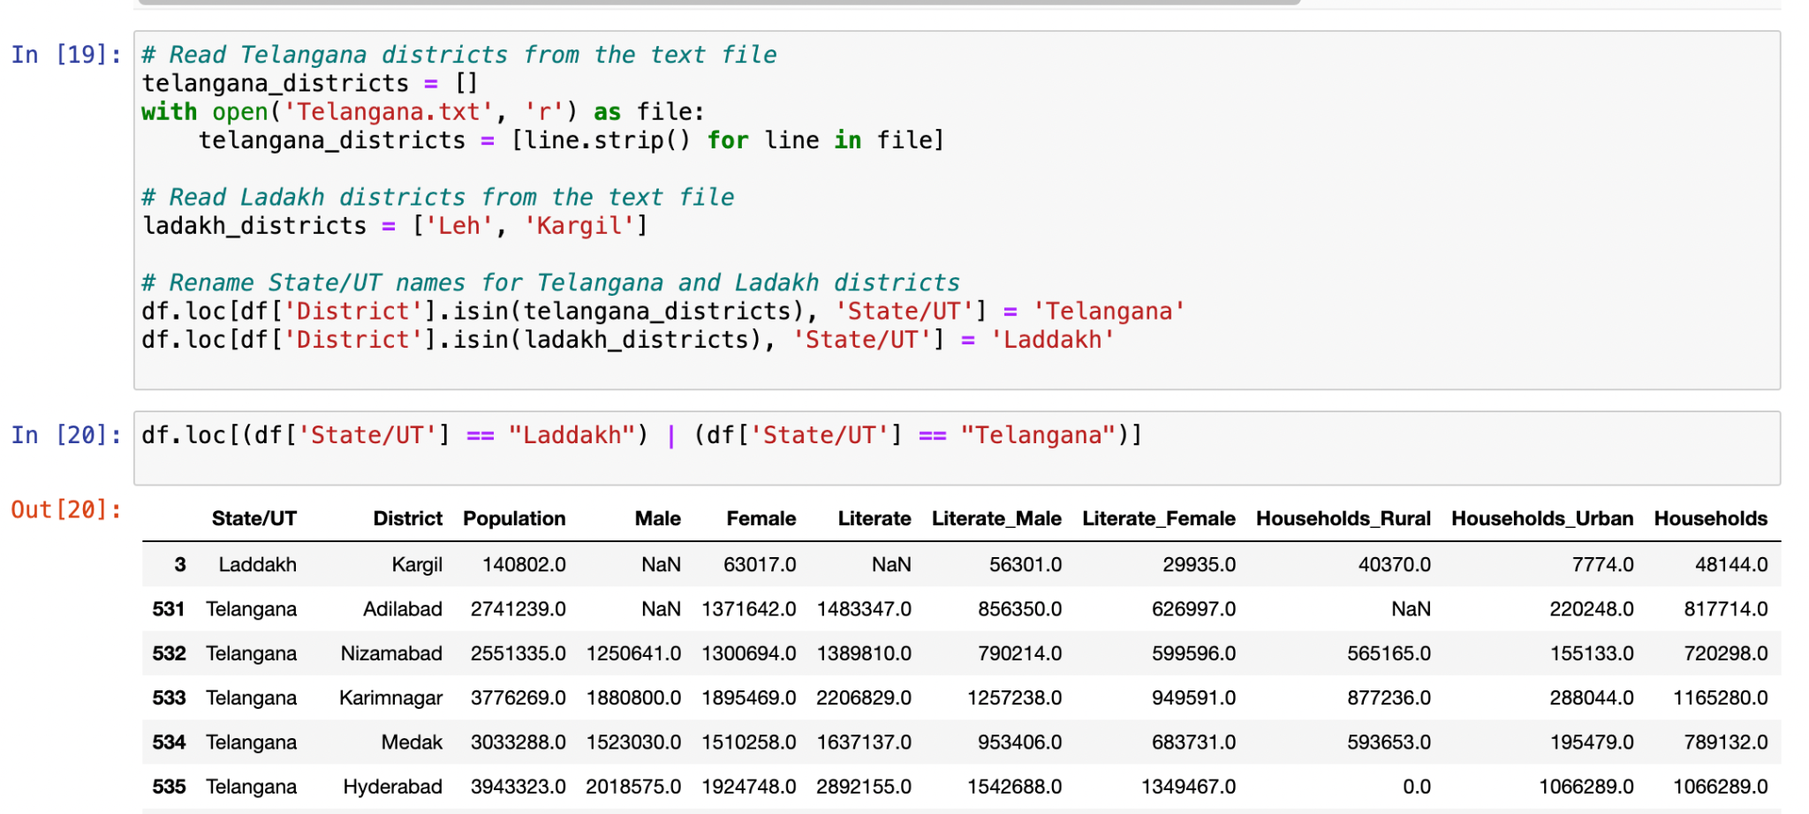
Code & Output
PS4: In 2014 Telangana was formed after it split from Andhra Pradesh, The districts that were included in Telangana are stored in Data/Telangana.txt . Read the text file and Rename the State/UT From “Andhra Pradesh” to “Telangana” for the given districts.
In 2019 Laddakh was formed after it split from Jammu and Kashmir, which included the districts Leh and Kargil. Rename the State/UT From “Jammu and Kashmir” to “Laddakh” for the given districts.

Slide 9
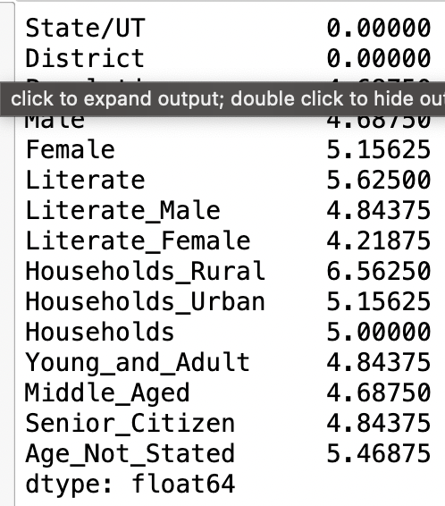
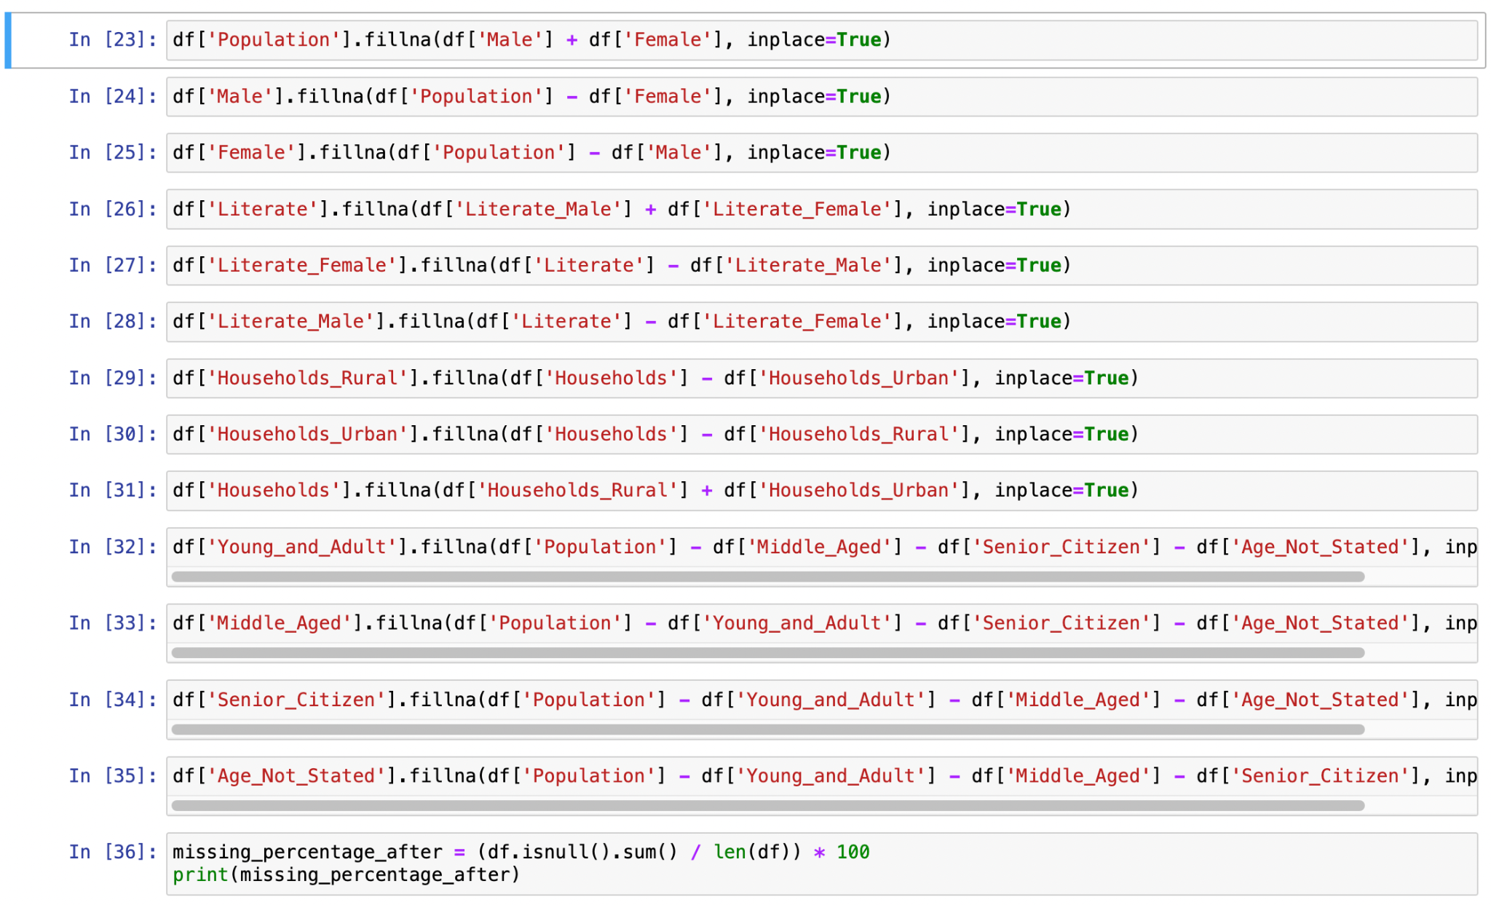
Code & Output
PS5: Find and store the percentage of data missing for each column.
Some data can be found and filled in by using information from other cells. Try to find the correct data by using information from other cells and filling it in. Find and store the percentage of data missing for each column.

Slide 10
Code & Output
PS6: Save the processed data to a CSV file named “census.csv” in the “Clean_Data” folder.

Slide 11
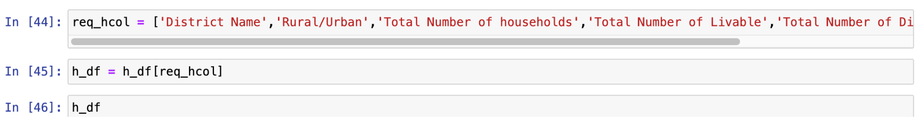
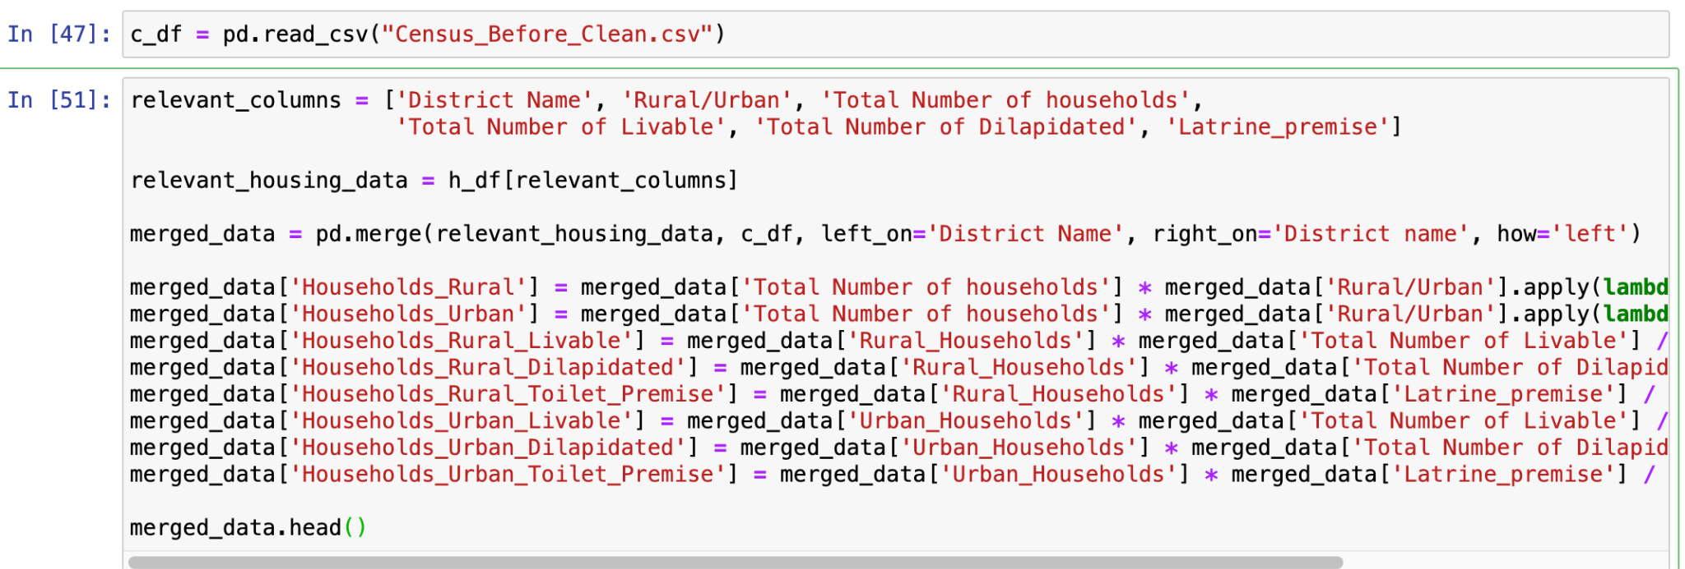
Code & Output
PS7: From the housing data(Data/housing.csv) read the following columns which may be relevant to the requirement.

Slide 12
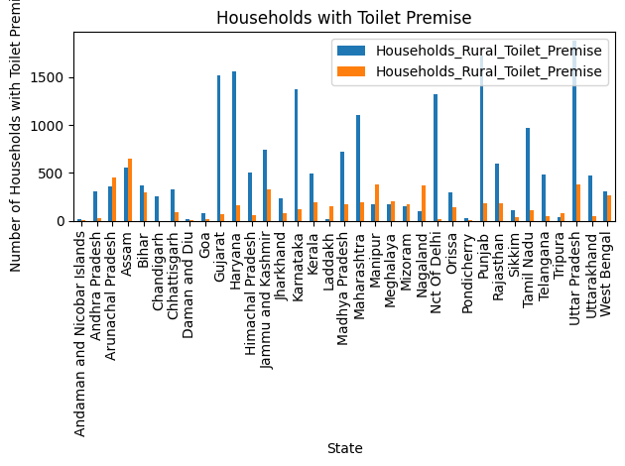
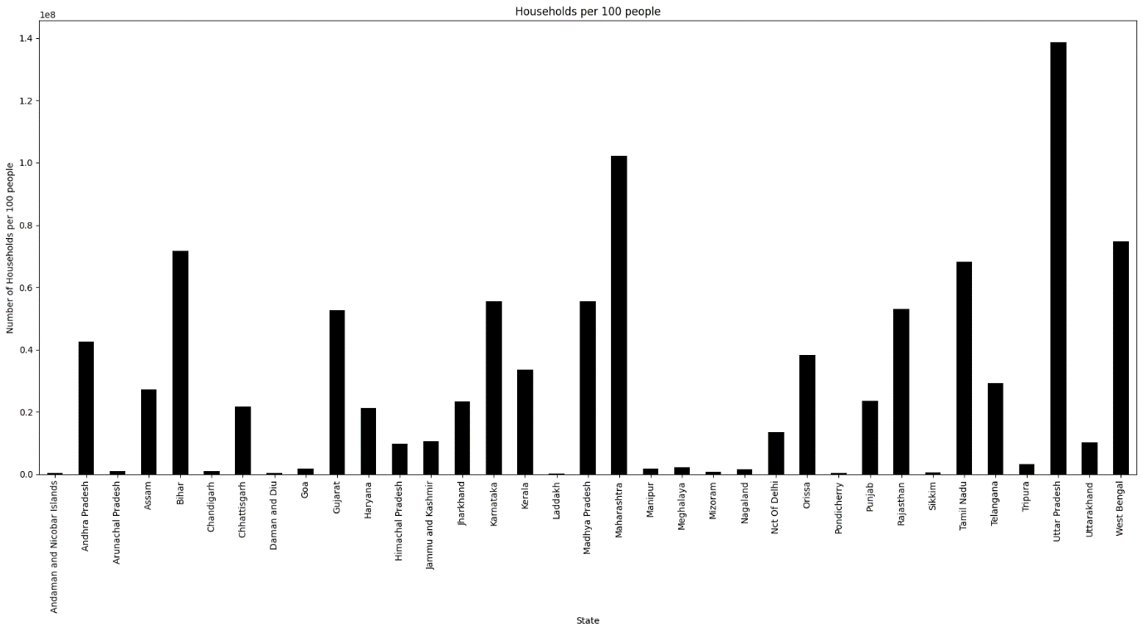
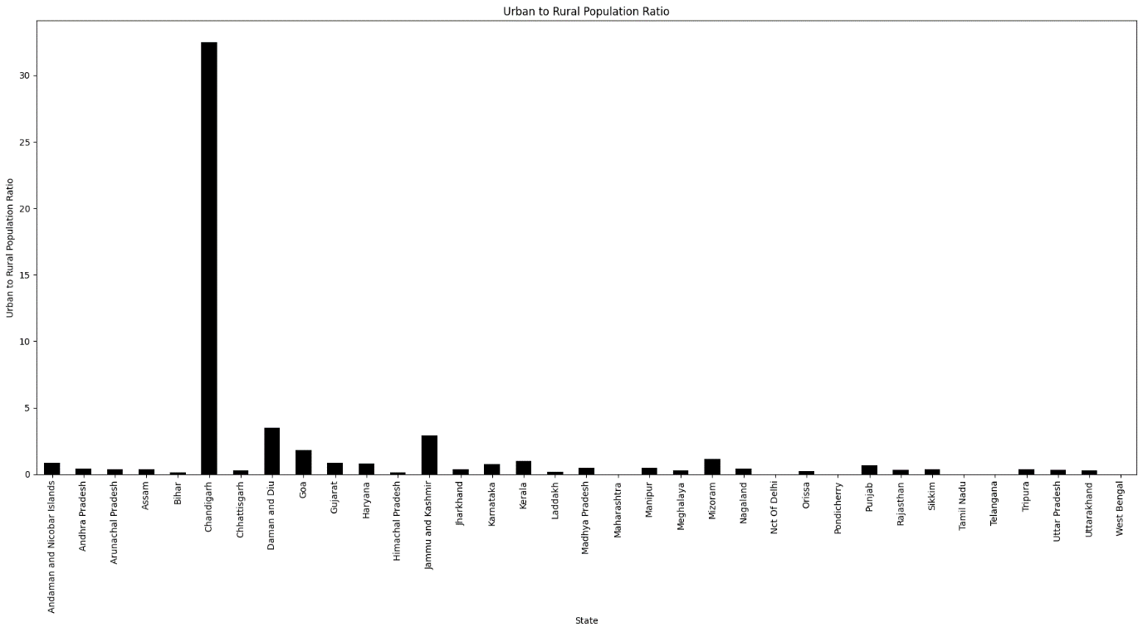
Code & Output
PS8: Visualize the following data for each state using appropriate methods:

Slide 13
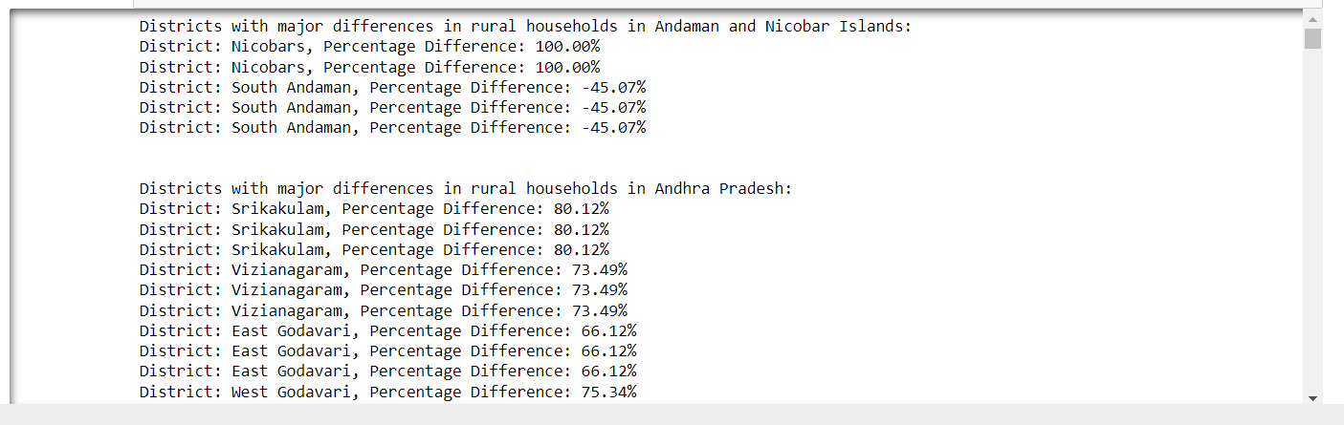
Code & Output
PS9: Inconsistency in different datasets

Slide 14
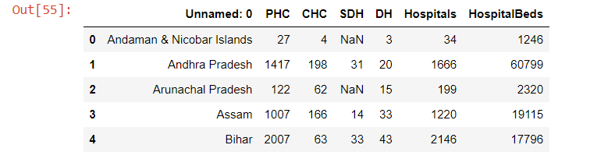
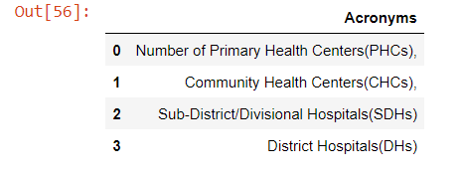
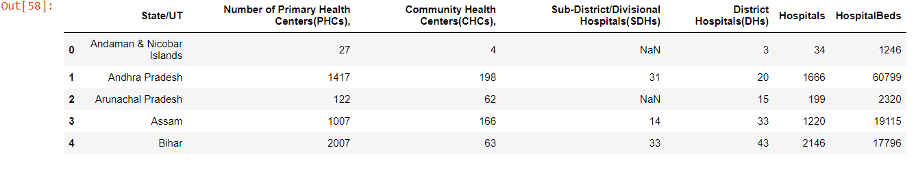
Code & Output
PS10: Import the hospital data from Data/hospitals.csv and make the necessary changes to the header :

Slide 15
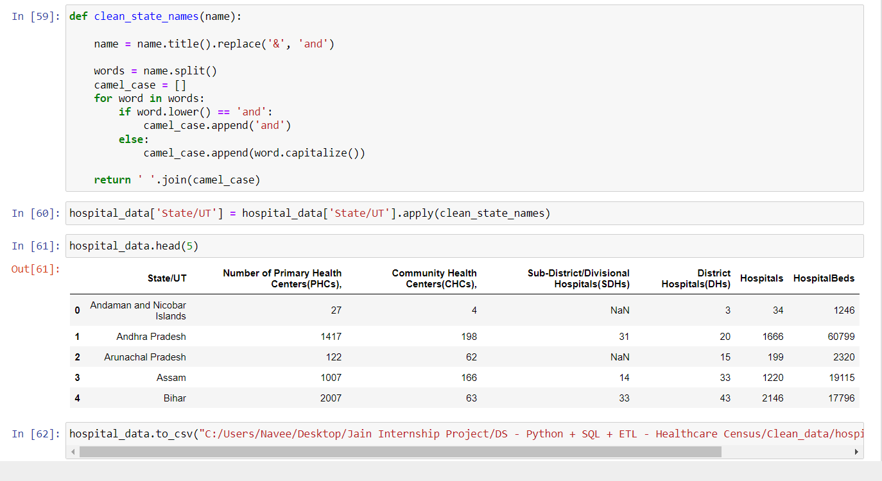
Code & Output
PS11: Create a function to alter the data to create uniformity:

Slide 16
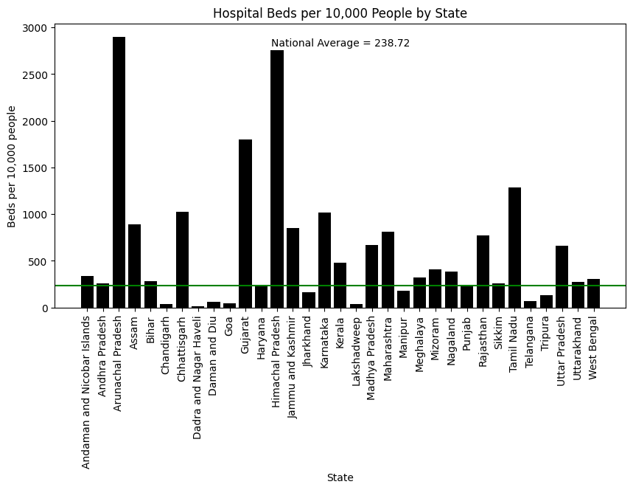
Code & Output
PS12: Analyze Healthcare facility disparity:

Slide 17
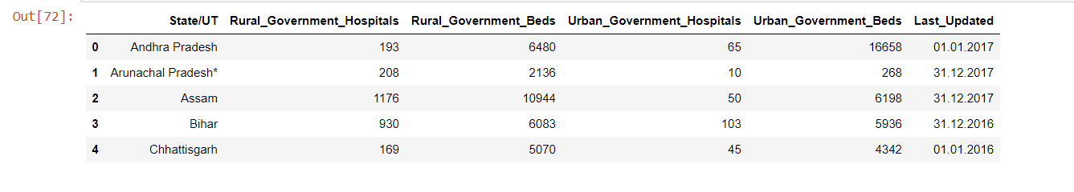
Code & Output
PS13: Multi-line header:

Slide 18
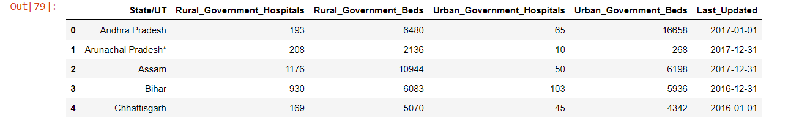
Code & Output
PS14: Data update and code reuse:

Slide 19
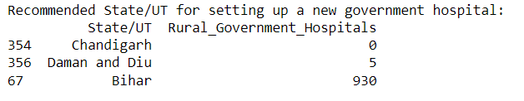
Code & Output
PS15: Government healthcare facility disparity:

Slide 20
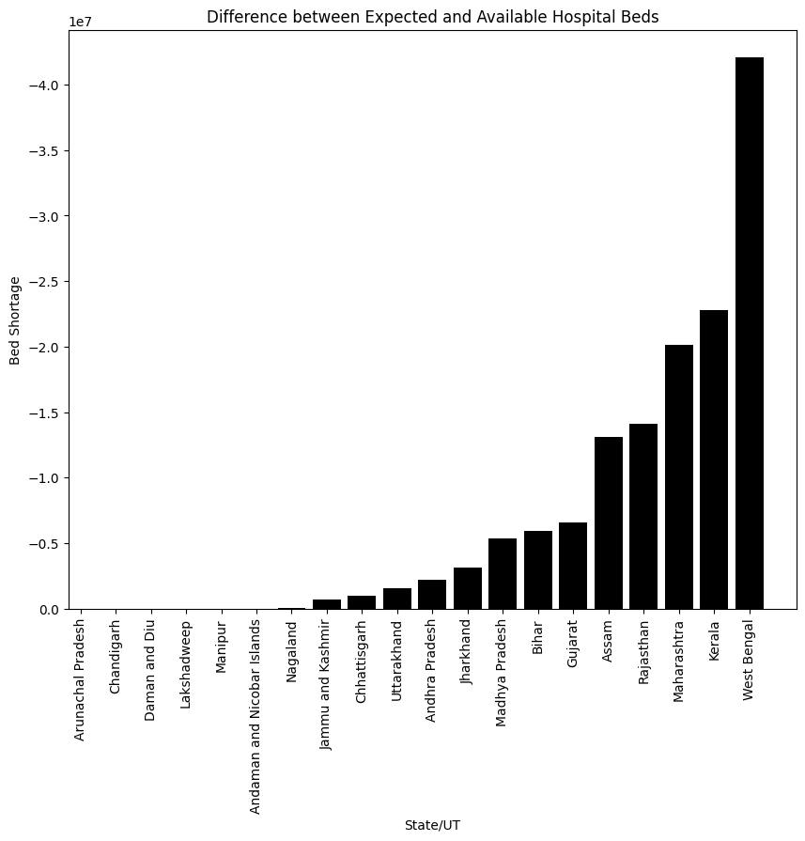
Code & Output
PS16: Gap in number of beds:

Slide 21
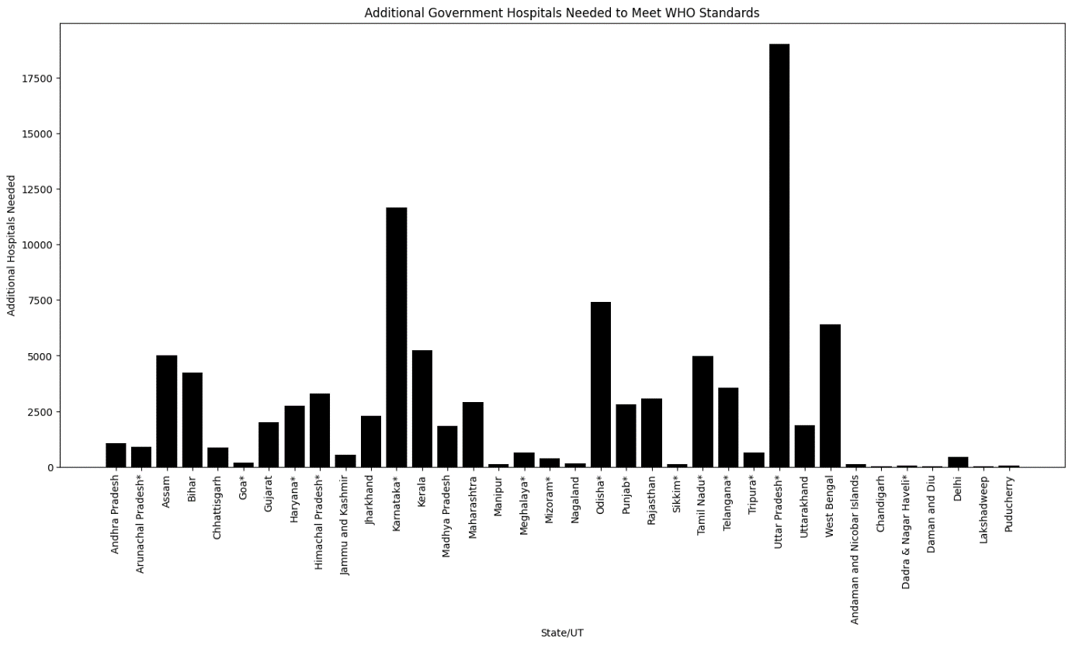
Code & Output
PS17: Hospitals required to meet the standards:

Slide 22
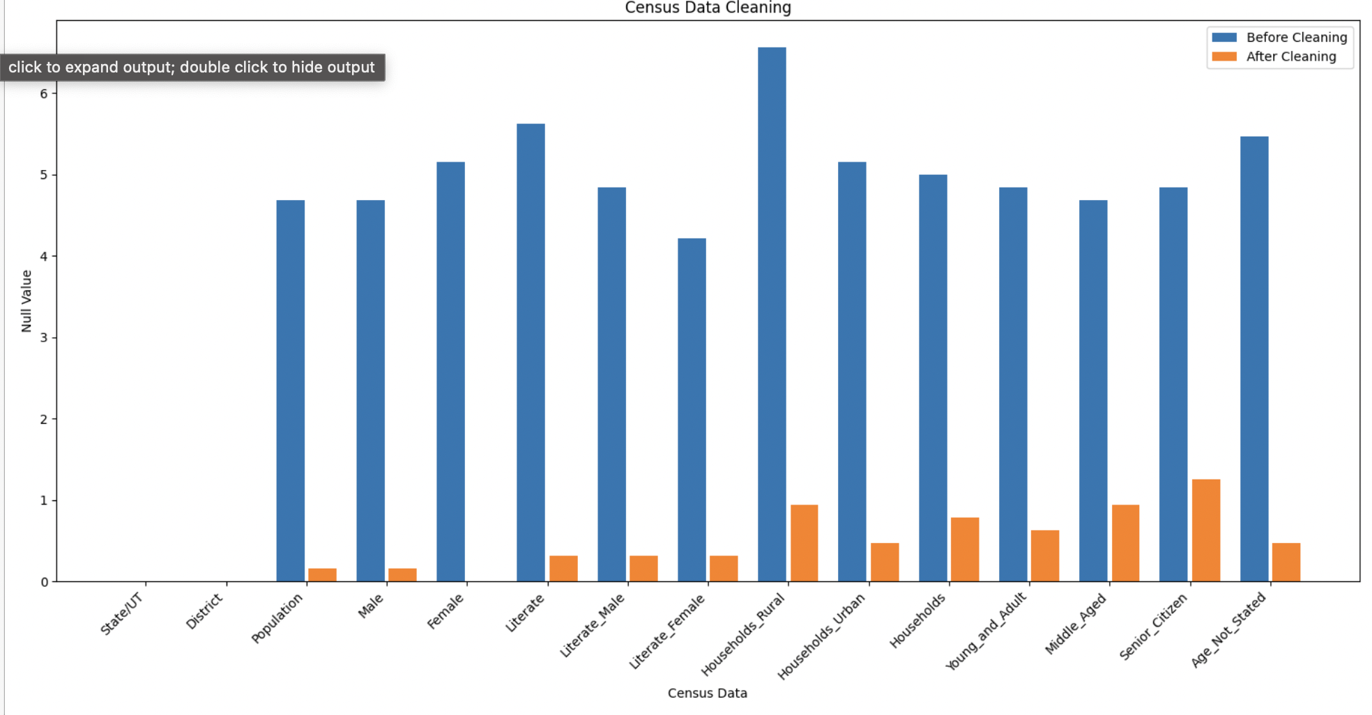
Figures/Graph

Slide 23
Conclusion
The project involved cleaning and enhancing the 2011 census data for the healthcare department's analysis. Irrelevant columns were removed, missing values were imputed using data relationships, and state/UT names were standardized. Visualizations were employed to compare missing data percentages before and after filling. the percentage of missing data before and after filling was mentioned. The resulting dataset is now well-structured and ready for further analysis, providing a foundation for informed decision-making by the healthcare department. The project utilized Python, Pandas, and Matplotlib, offering a systematic and efficient approach within Jupyter Notebooks.

Slide 24
Thank you!!!

